Slide 1

European Conference on EDGE AI
Technologies and Applications - EEAI
Connecting the future and driving the next wave of technological advancements for a better world.
21-23 October 2024, Cagliari, Sardinia, Italy

Slide 2
Multi-Step Object Re-Identification on Edge Devices: A Pipeline for Vehicle Re-Identification
Tomass Zutis, Pēteris Račinskis, Anželika Bureka, Jānis Judvaitis, Jānis Ārents, Modris Greitāns,
EDI, Latvia

Slide 3

Presentation Outline
Introduction
Research goal / Methodology
State-of-the-art
Testing and data collection
Experimental Settings
Results
Conclusion
Future Research

Slide 4
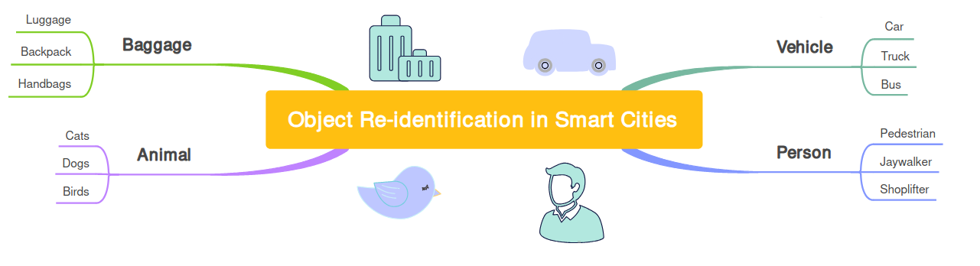
Introduction
The solution has been developed in the Value Chain 4 of EdgeAI project demonstrator VCD4.2: Roadside Perception Units (RSPU) connected with a LoRa 2.4 GHz mesh network

Slide 5
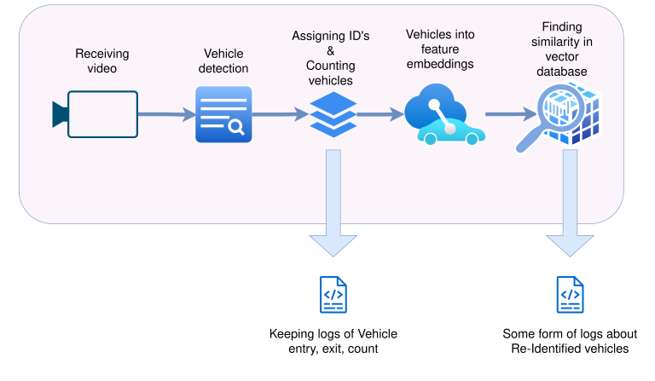
Research Goal / Methodology

Slide 6
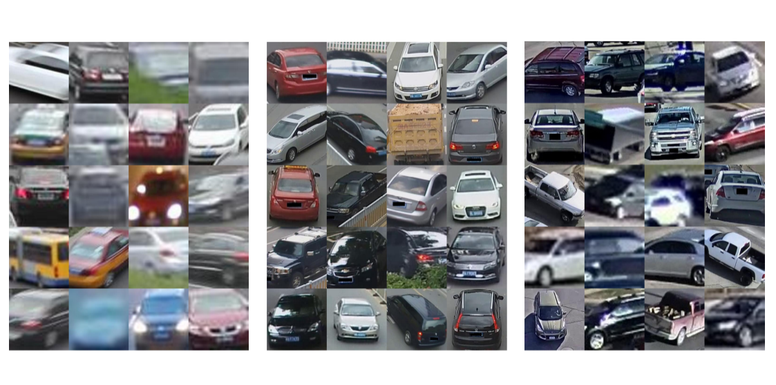
State-of-the-art
Object detection
Feature extraction model
Available datasets

Slide 7
Testing and data collection
Publicly available datasets (VeRi, Vehicle-ID, CityFlow)
Video tracks (CityFlow)
Custom made dataset from network cameras

Slide 8
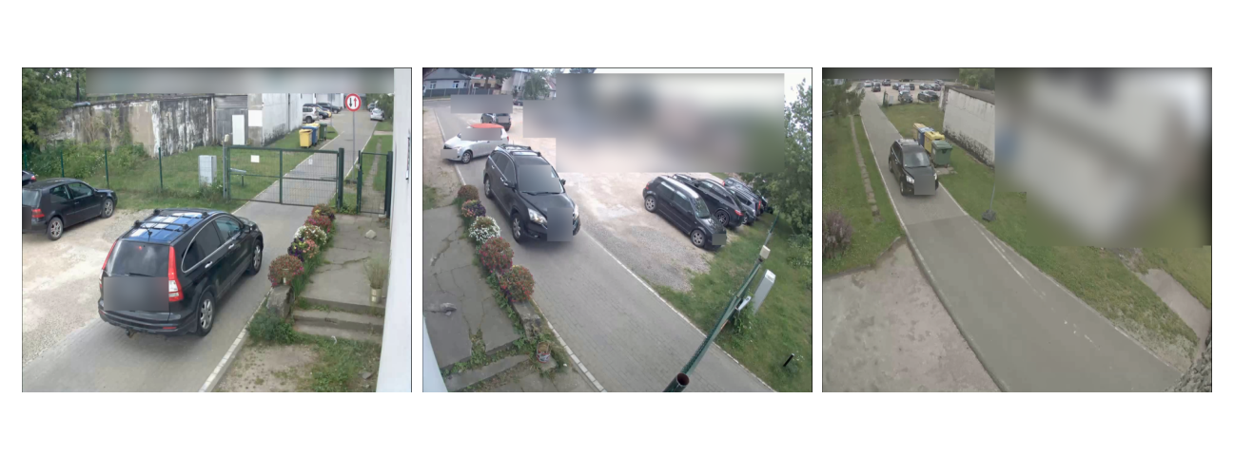
Custom made dataset

Slide 9
Experimental Settings and methods
Finding:
The dataset that lets model generalize best on custom data
The best ways to train the model
The differences in performance between our cameras
The best approaches of capturing and saving embeddings

Slide 10

Experimental Settings

Slide 11
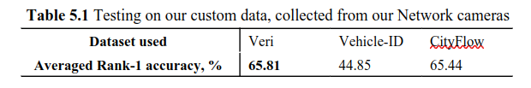
Results
VeRi Trained Model comparisons on the VeRi-776 benchmark
Model | Rank-1, % | mAP, %
trained on Veri, 19th epoch | 93.80 | 68.96
trained on Veri, 49th epoch | 94.04 | 69.4
with updated parameters | 95.47 | 71.70
VehicleX synthetic data added | 95.83 | 73.64

Slide 12
Results
Camera 3 embeddings
>
Camera 1 & 2 embeddings
1.
Individual vectors
>
Vector summing
2.
Zone saving
>
Frame by frame saving

Slide 13
Conclusion
Multi-step pipeline / customized solution
Generalization capability of embeddings
Real-time performance - on the edge

Slide 14
Future Research
Standardising performance between different scenarios
Fine-tuning models trained on public datasets with our in-house data
A more in-depth analysis of feature vectors

Slide 15





Thank You
j
Acknowledgement:
EdgeAI (Edge AI Technologies for Optimised Performance Embedded Processing) develops new electronic components and systems, processing architectures, connectivity, software, algorithms, and middleware through the combination of microelectronics, edge AI, embedded systems, and edge computing. www.edge-ai-tech.eu
For your attention
tomass.zutis@edi.lv
Copyright © 2024

Slide 16




Event Organisers
EdgeAI
ANDANTE
SMARTY
AI4DI
EdgeAI (Edge AI Technologies for Optimised Performance Embedded Processing) develops new electronic components and systems, processing architectures, connectivity, software, algorithms, and middleware through the combination of microelectronics, edge AI, embedded systems, and edge computing. www.edge-ai-tech.eu
The ANDANTE project has received funding from the ECSEL Joint Undertaking (JU) under grant agreement No 876925. The JU receives support from the European Union’s Horizon 2020 research and innovation programme and Belgium, France, Germany, The Netherlands, Portugal, Spain, Switzerland. www.andante-ai.eu
SMARTY - Scalable and Quantum Resilient Heterogeneous Edge Computing enabling Trustworthy, focuses on cloud-edge continuum for heterogeneous systems, that protects data-in-transit and data-in-process, employing novel accelerators for quantum resilient communications, confidential computing, and software defined perimeters. https://www.smarty-project.eu/
The AI4DI project has received funding from the ECSEL Joint Undertaking (JU) under grant agreement No 826060. The JU receives support from the European Union’s Horizon 2020 research and innovation programme and the national authorities. www.ai4di.eu

Slide 17




Event Organisers
AI4CSM
TRISTAN
CLEVER
REBECCA
AI4CSM (Automotive Intelligence for Connected Shared Mobility) develops advanced electronic components and systems (ECS) and architectures for future mass-market ECAS vehicles based on sensor fusion and perception platforms, efficient propulsion and energy modules, advanced connectivity and trustworthy AI techniques and methods. www.ai4csm.eu
The ANDANTE project has received funding from the ECSEL Joint Undertaking (JU) under grant agreement No 876925. The JU receives support from the European Union’s Horizon 2020 research and innovation programme and Belgium, France, Germany, The Netherlands, Portugal, Spain, Switzerland. www.tristan-project.eu
CLEVER (Collaborative edge-cLoud continuum and Embedded AI for a Visionary industry of thE futuRe) proposes innovations in hardware accelerators, design stack, and middleware software that revolutionize the ability of edge computing platforms to operate federated, leveraging sparse resources that are coordinated to create a powerful swarm of resources. www.cleverproject.eu
REBECCA (Reconfigurable Heterogeneous Highly Parallel Processing Platform for safe and secure AI) aims to democratize the development of edge AI systems and create a complete hardware and software stack centered around a RISC-V CPU, which offer higher performance, energy efficiency, safety, and security than existing systems. www.rebecca-chip.eu

Slide 18



Event Organisers
dAIEDGE
SMARTEDGE
NEUROKIT2E
LoLiPoP IoT
dAIEDGE is the European Network of Excellence for distributed, trustworthy, efficient, and scalable AI at the Edge and promotes the application, development, and deployment of Artificial Intelligence (AI) on edge computing platforms. https://daiedge.eu/
The SmartEdge project aims to achieve dynamic integration of decentralized edge intelligence while prioritizing reliability, security, privacy, and scalability. The SmartEdge solution includes a low-code tool programming environment with three main tools: Continuous Semantic Integration, Dynamic Swarm Network, and Low-code Toolchain for Edge Intelligence. https://www.smart-edge.eu/
NEUROKIT2E (Open source deep learning platform dedicated to Embedded hardware and Europe) proposes a Deep Learning Platform for Embedded Hardware around an established European value chain (AI HW/SW). The solutions developed support neural network design, optimisation, and implementation on constrained HW. https://www.neurokit2e.eu/
NEUROKIT2E
The objectives of LoLiPoP IoT (Long Life Power Platforms for Internet of Things) are to develop energy harvesting-based innovative Long Life Power Platforms that enable retrofit of wireless sensor network edge devices for asset tracking, condition and performance monitoring. www.lolipop-iot.eu

Slide 19





Supporting Organizations
EU
AENEAS
EPoSS
INSIDE
Chips JU
AENEAS standing for Association for European NanoElectronics ActivitieS, is an industrial Association, established in 2006, providing unparalleled networking opportunities, policy influence & supported access to funding to all types RD&I participants in the field of micro and nanoelectronics enabled components and systems. https://aeneas-office.org/
The European Technology Platform on Smart Systems Integration is an industry-driven policy initiative, defining research, development and innovation needs as well as policy requirements related to Smart Systems Integration and integrated Micro- and Nanosystems. The main objective is to develop a vision and to set up a Strategic Research Agenda. www.smart-systems-integration.org
Inside Industry Association is the European Technology Platform for research, design and innovation on Intelligent Digital Systems and their applications. The Association is a membership organisation for the European research and innovation actors with more than 200 members and associates from all over Europe. www.inside-association.eu
Chips Joint Undertaking supports research, development, innovation, and future manufacturing capacities in the European semiconductor ecosystem. Launched as part of the Chips for Europe Initiative, it confronts semiconductor shortages and strengthens Europe's digital autonomy, engaging a significant EU, national/regional and private industry funding of nearly €11 billion. https://portal.chips-ju.europa.eu/

